Slide 1
What the f**k Web Services
Why the hell I need to learn Web Services

Slide 2
“Web Services”
1. What are Web Services ?
2. Why Web Services ?

Slide 3


Slide 4
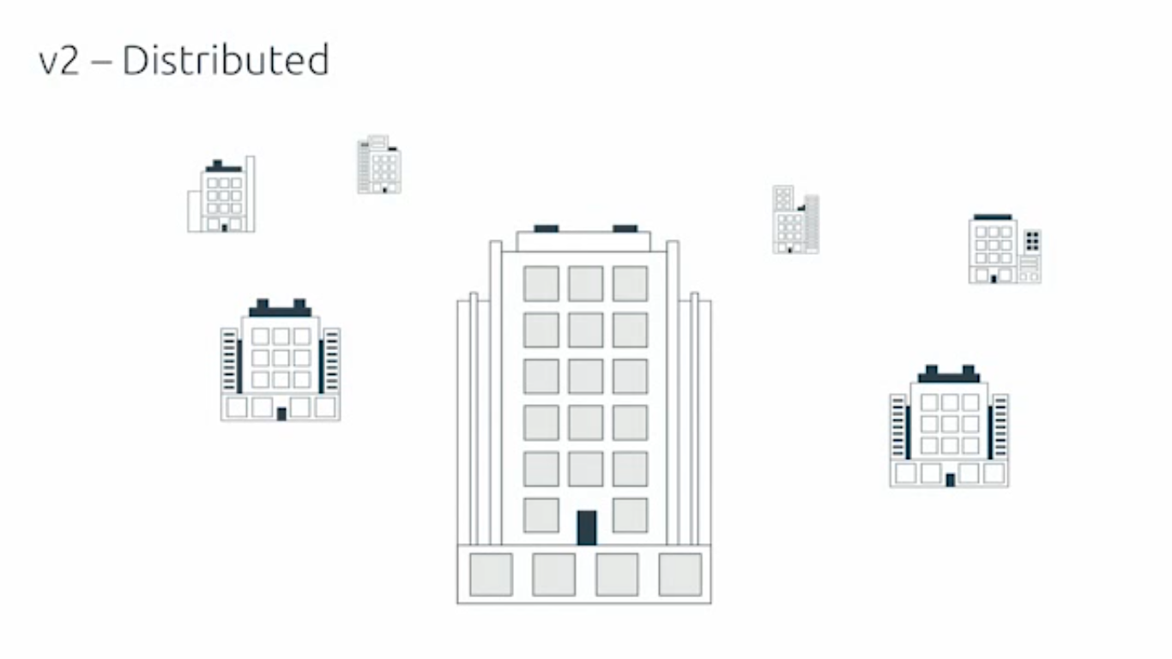

Slide 5
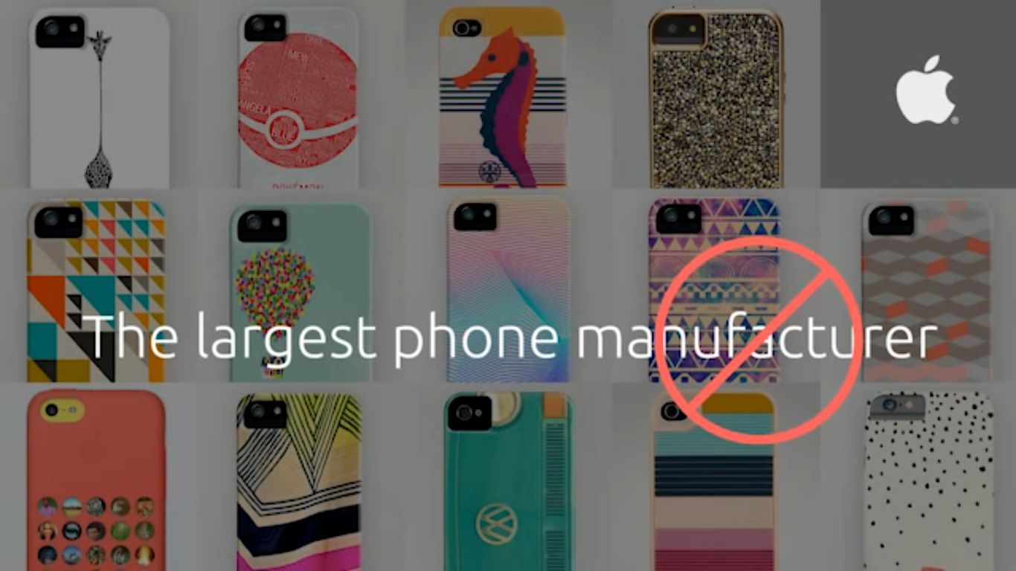

Slide 6
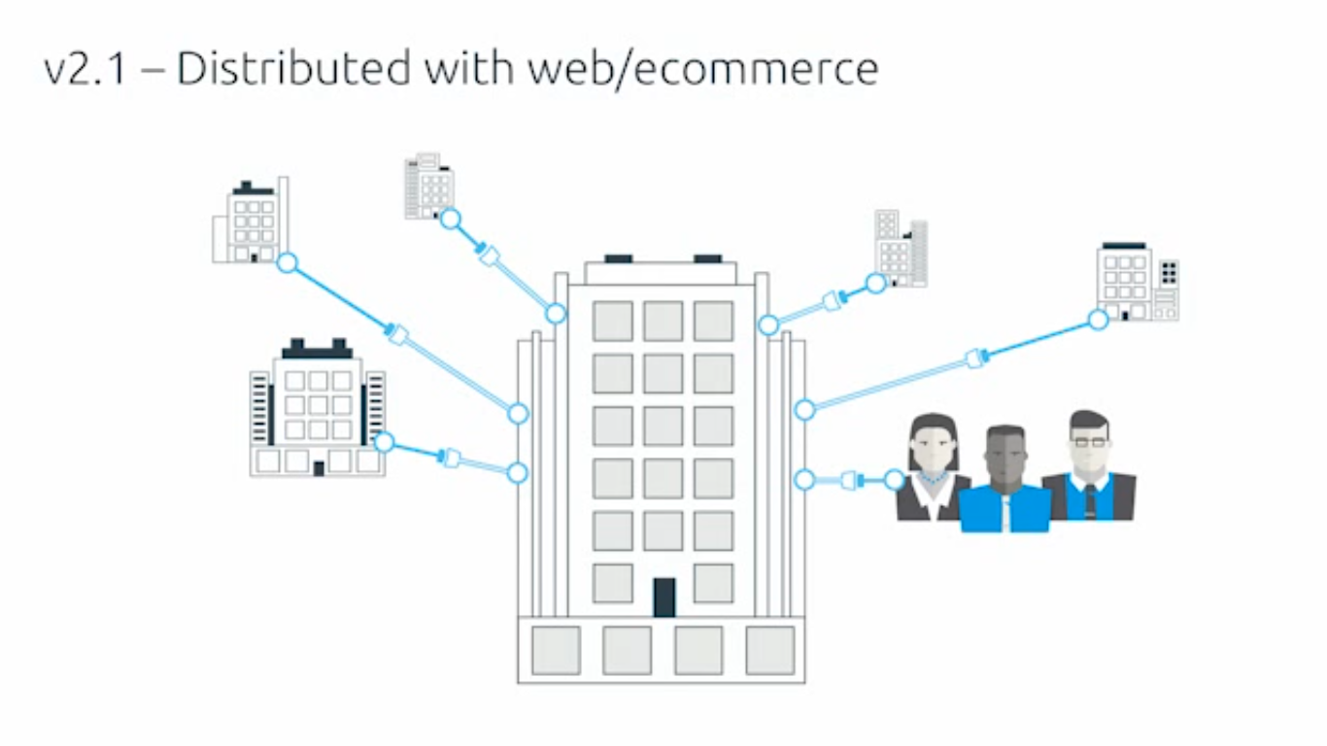

Slide 7
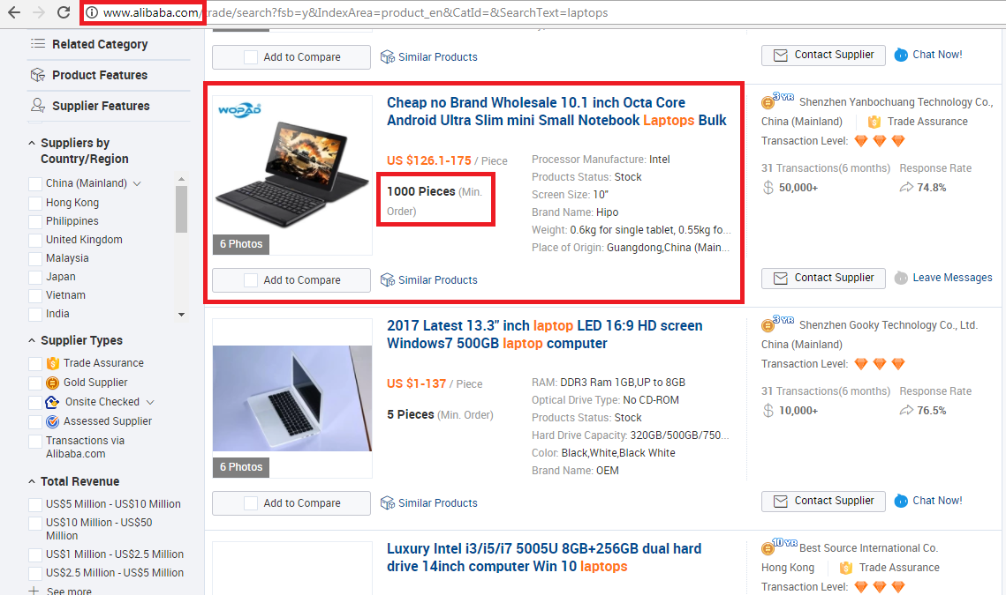

Slide 8
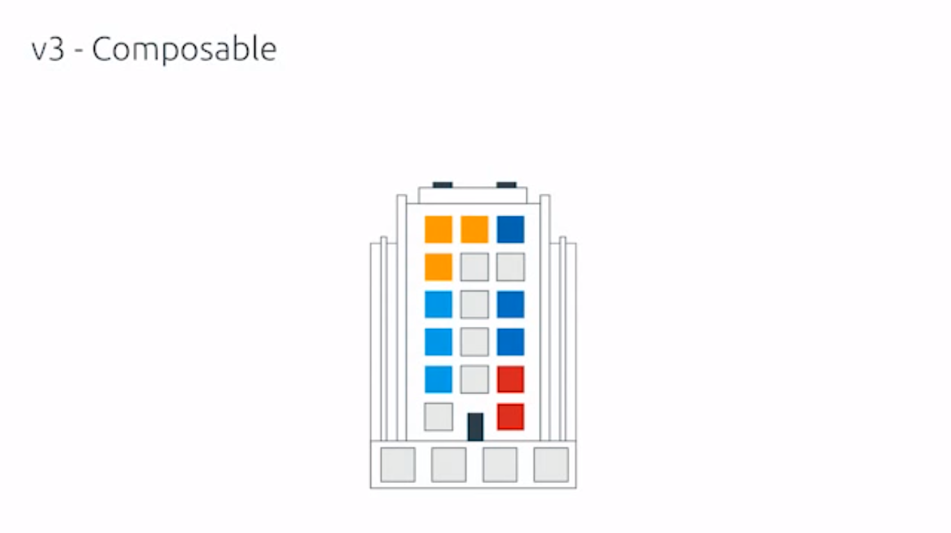

Slide 9
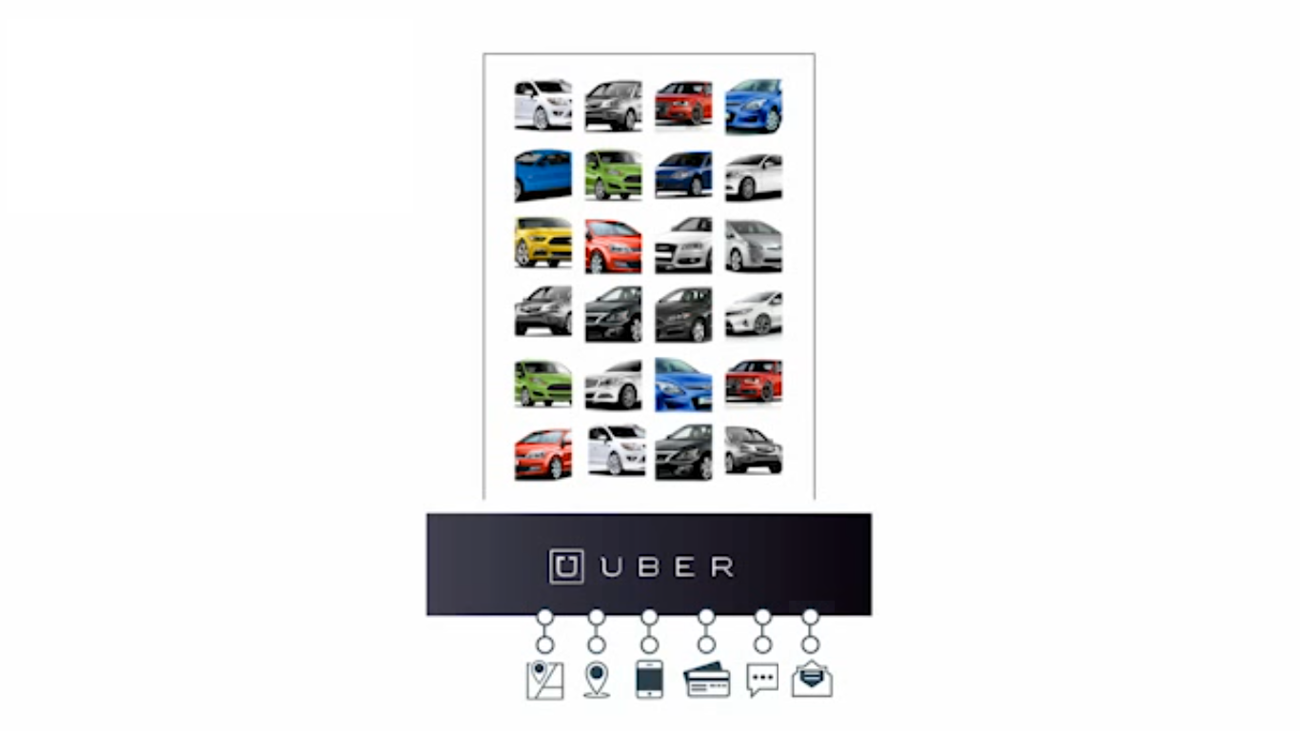

Slide 10
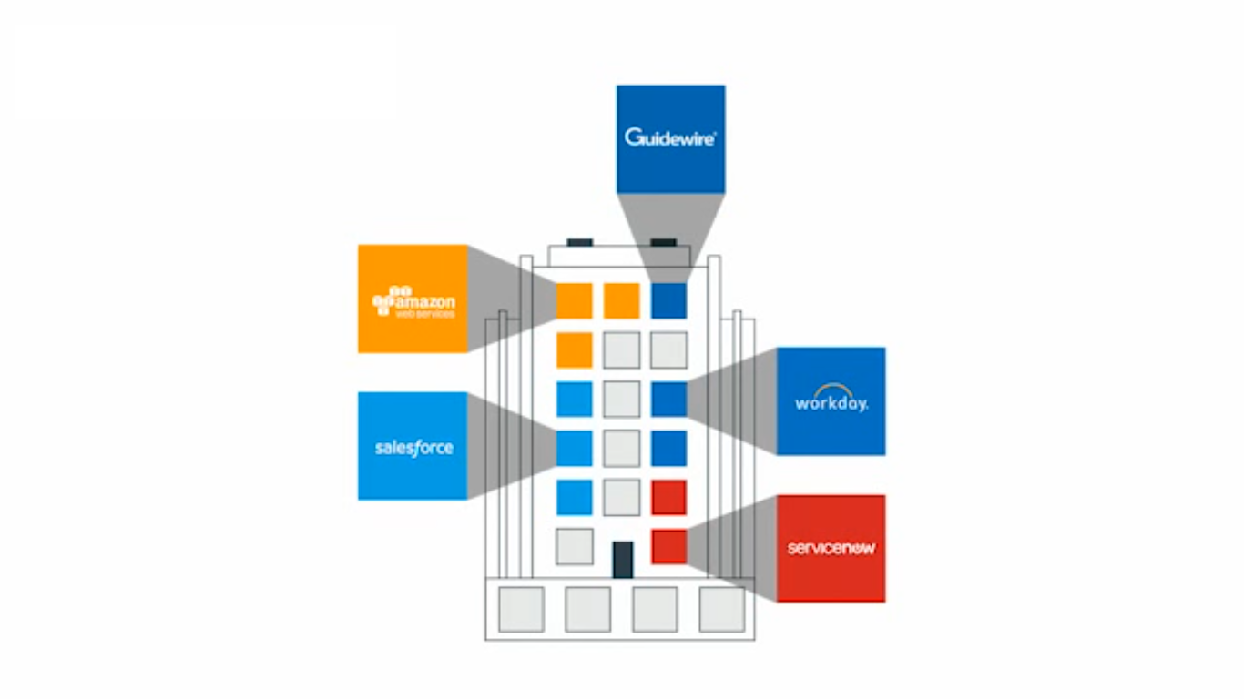

Slide 11
Web Applications are opening communication channels
(via REST APIs)
which brings extra Business !!!

Slide 12
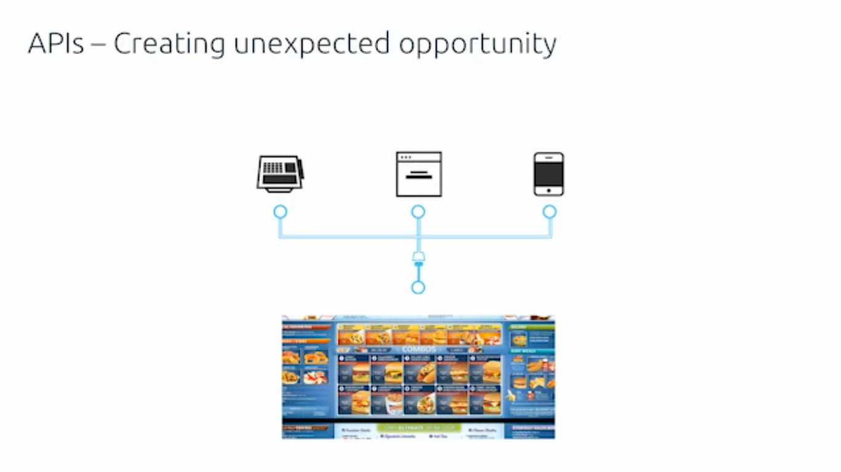

Slide 13
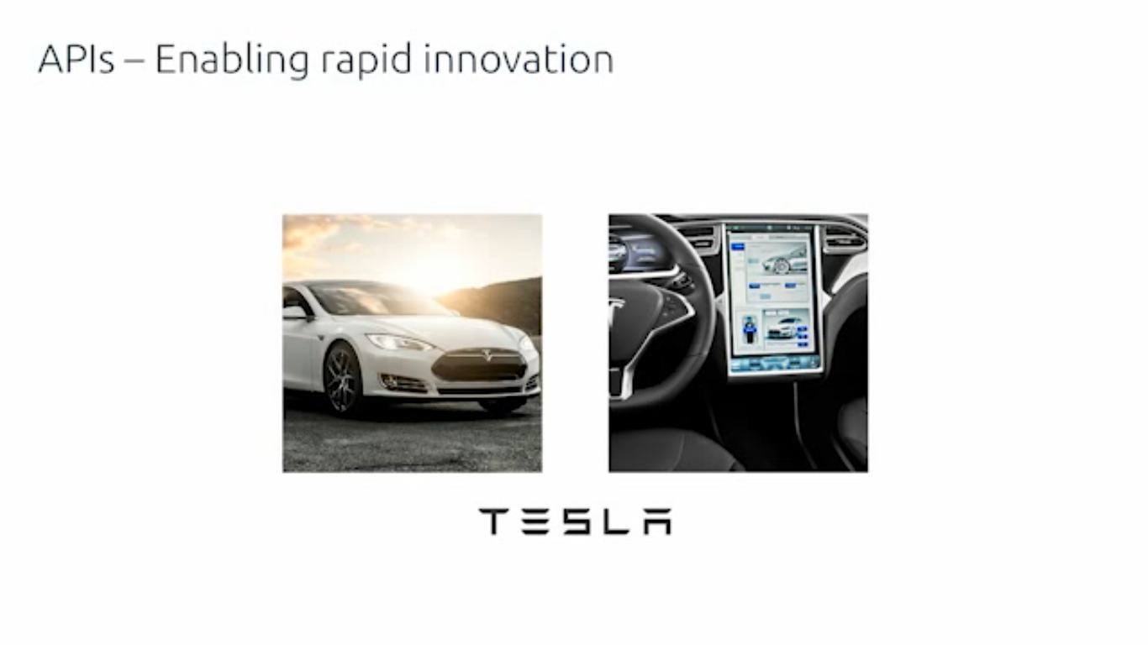

Slide 14
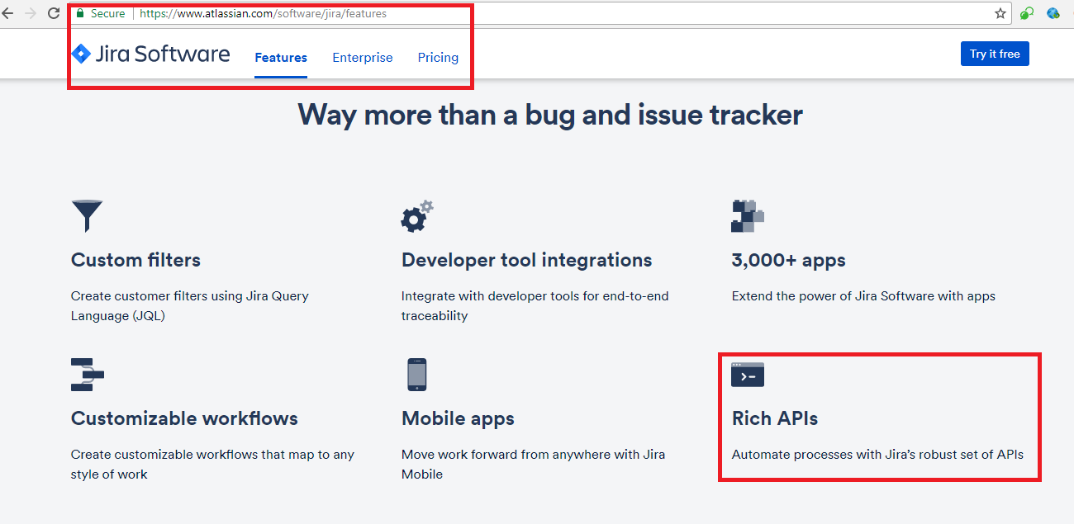

Slide 15
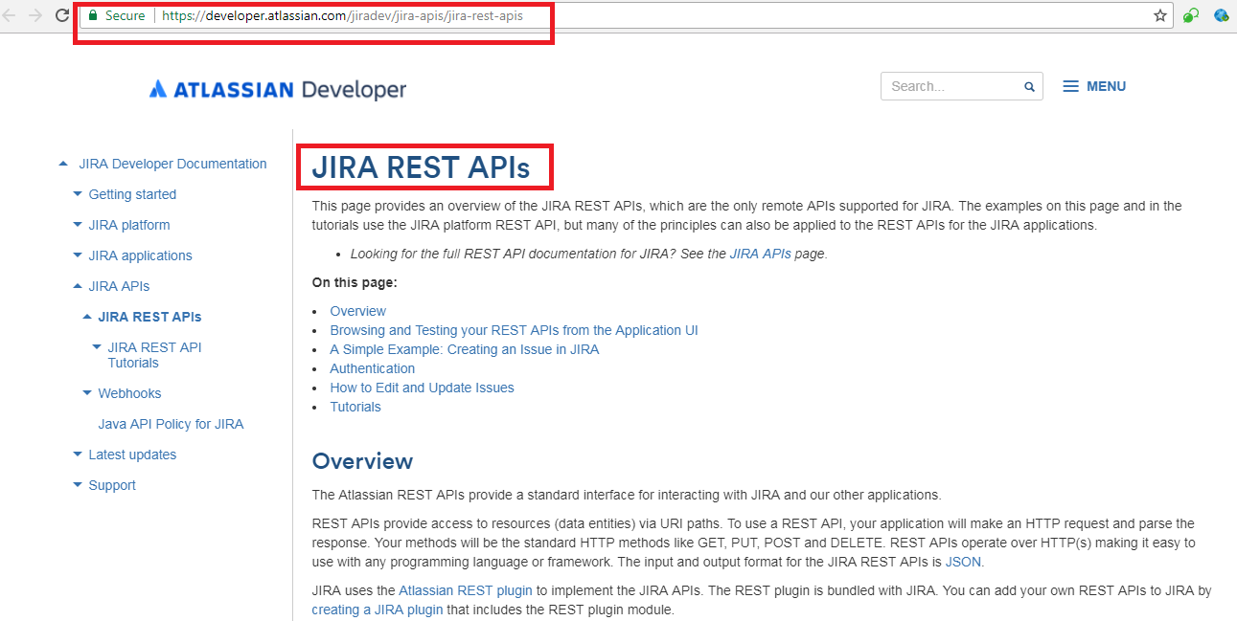

Slide 16
Artificial Intelligence (AI) uses
Web Services for Communication

